Slide 1
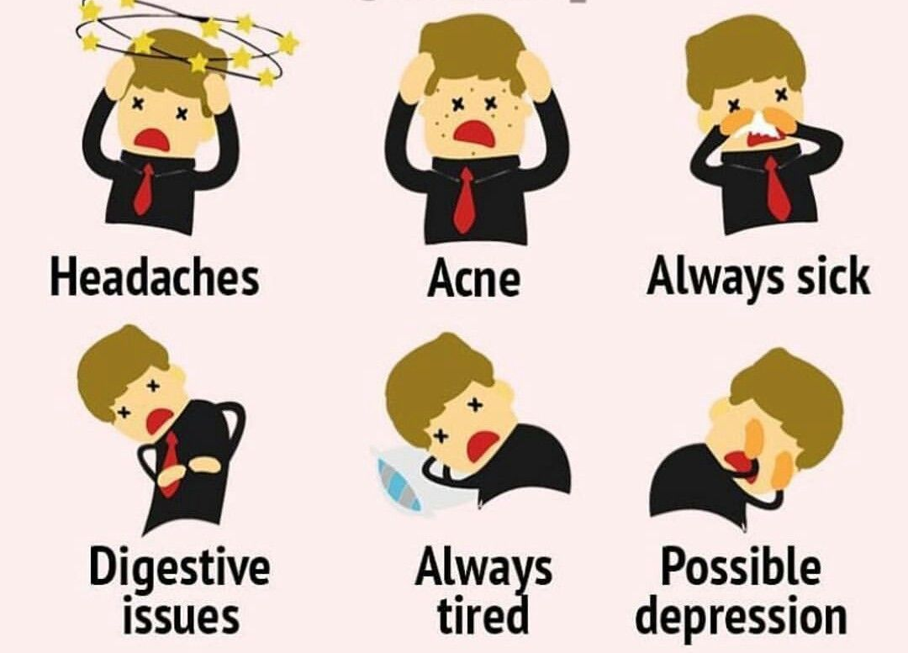


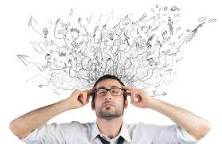
STRESS
Health and Lifestyle
Class - 14

Slide 2

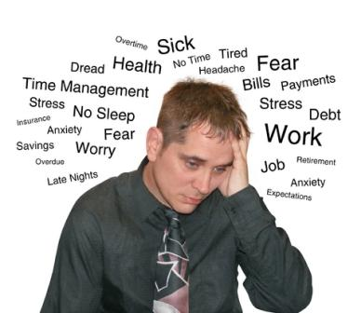
STRESS
Everyone is affected by stress and reacts to it in different ways.
Stress is a way that our body responds to the demands made upon us by the environment, our relationships and our perceptions and interpretations of those demands.
We all experience both “good stress” and “bad stress.” Good stress is that optimal amount of stress that results in our feeling energized and motivated to do our best work.

Slide 3
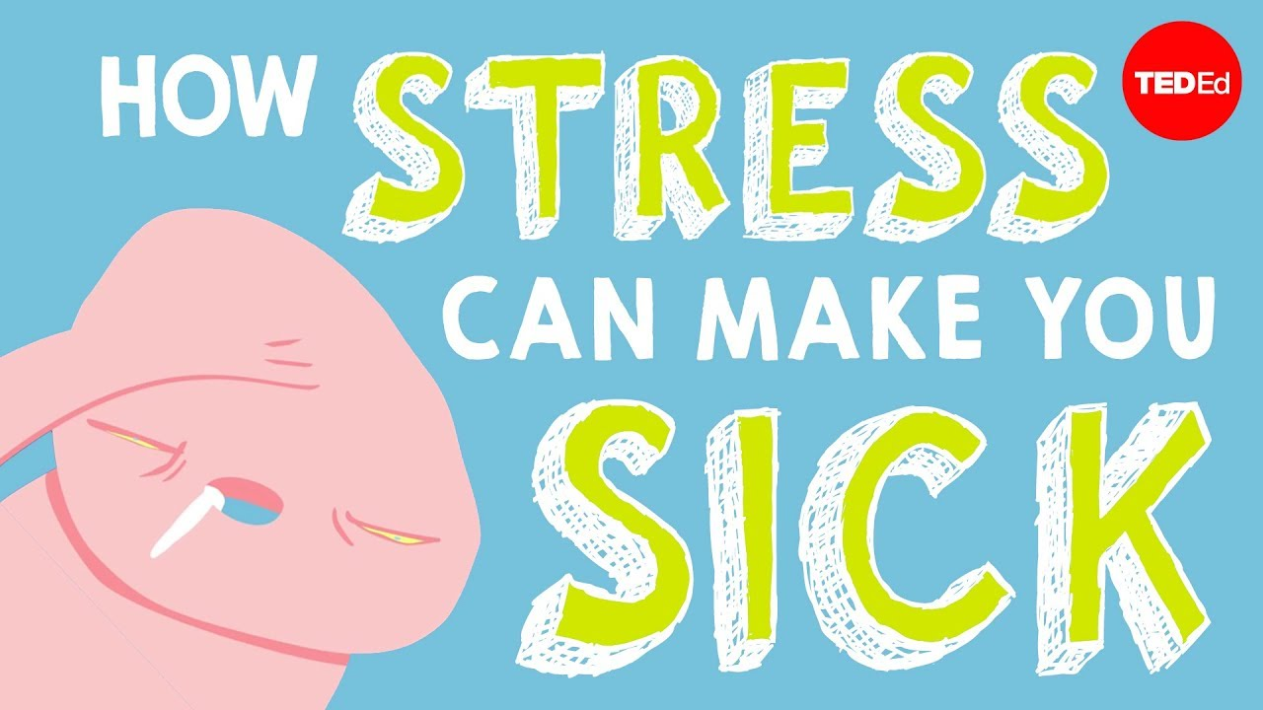
SYMPTOMS OF STRESS
Headaches, other aches and pains
Sleep disturbance,
Insomnia
Upset stomach, indigestion, diarrhoea
Anxiety
Anger, irritability
Depression
Fatigue
Feeling overwhelmed and out of control
Feeling moody, tearful
Difficulty concentrating
Low self-esteem, lack of confidence
High blood pressure
Weakened immune system
Heart disease

Slide 4
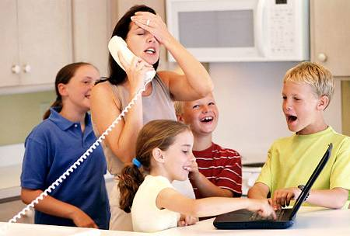
CAUSES OF STRESS
Stress at Home
Death of spouse, family, near relative or friend.
Injury or illness of any family member.
Marriage of self or son or daughter or brother or sister.
Separation or divorce from partner.
Pregnancy or birth of a new baby.
Children's behavior or disobedience.
Children's educational performance.
Hyperactive children.
Sexual molestation.
Argument or heated conversations with spouse, family members or friends or neighbors.
Not sufficient money to meet out daily expenses or unexpected expenditure.
Not sufficient money to raise your standard of living.
Loss of money in burglary, pick-pocketed or share market.
Moving house.
Change of place or change of city or change of country.

Slide 5

Stress at Work
To meet out the demands of the job.
Your relationship with colleagues.
To control staff under you.
To train your staff and take work from them.
Support you receive from your boss, colleagues and juniors.
Excessive work pressure.
To meet out deadlines.
To give new results.
To produce new publications if you are in research area.
Working overtime and on holidays.
New work hours.
Promotion or you have not been promoted or your junior has superseded you.
Argument or heated conversations with co-workers or boss.
Change of job.
Work against will.
Harassment.
Sexual molestation.

Slide 6


Other Causes of Stress
Fear, intermittent or continuous.
Threats: physical threats, social threats, financial threat, other threats.
Uncertainty.
Lack of sleep.
Somebody misunderstands you.
Setback to your position in society.

Slide 7
GOOD AND BAD STRESS
GOOD STRESS:
The type of stress we feel when we are excited. Our pulse quickens and our hormones surge, but there is no threat or fear. We feel this type of stress when we ride a roller coaster, compete for a promotion, or go on a first date.
Examples of positive personal stressors include:
Receiving a promotion or raise at work.
Starting a new job.
Marriage.
Buying a home.
Having a child.
BAD STRESS:
Bad stress is also known as Distress (Negative Stress). Is the stress that your body goes through when it is over work.
Examples of negative personal stressors include:
The death of a spouse.
Filing for divorce.
Losing contact with loved ones.
The death of a family member.
Hospitalization (oneself or a family member)
Injury or illness (oneself or a family member)
Being abused or neglected.

Slide 8
Types of Stress
Three types of stress may be distinguished:
1. Acute stress
Acute stress is usually for short time and may be due to work pressure, meeting deadlines pressure or minor accident, over exertion, increased physical activity, searching something but you misplaced it, or similar things.
Acute Stress Symptoms are headaches, back pain, stomach problems, rapid heartbeat, muscle aches or body pain.
Acute stress is common in people who take too many responsibilities and are overloaded or overworked, disorganized, always in a hurry and never in time.
These people are generally in positions of importance at their workplace and stressful lifestyle is inherent in them

Slide 9
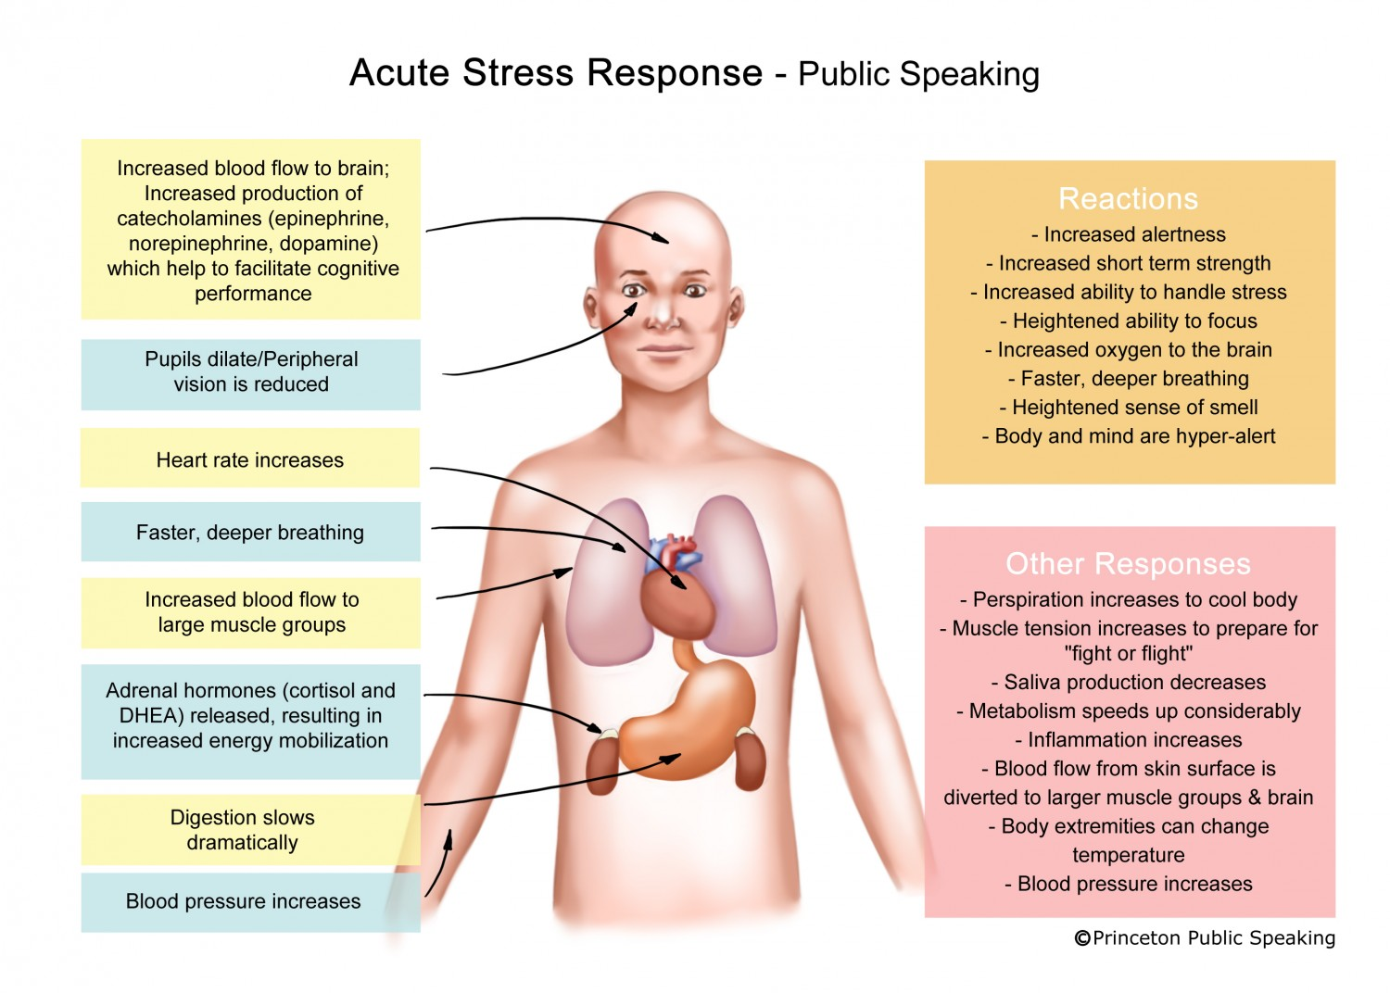

Slide 10
2. Episodic Stress
Acute stress that is suffered too frequently is called episodic stress.
This type of stress is usually seen in people who make self-inflicted, unrealistic or unreasonable demands which get all clamored up and bring too much stress in their attempt to accomplish these goals.
Episodic stress is not like chronic stress, though, because this type of stress ceases from time to time yet not as frequently as acute stress does.
Episodic stress is also typically observed in people with “Type A” personality, which involves being overly competitive, aggressive, demanding and sometimes tense and hostile. Because of this, the symptoms of episodic stress are found in Type A persons.
These include:
Longer periods of intermitted depression, anxiety disorders and emotional distress
Ceaseless worrying
Persistent physical symptoms similar to those found in acute stress
Coronary heart diseases, or other heart problems.

Slide 11
3. Chronic Stress
Third type of stress is called chronic stress.
This involves ongoing demands, pressures and worries that seem to go on forever, with little hope of letting up.
Chronic stress is very harmful to people’s health and happiness.
Even though people can sometimes get used to chronic stress, and may feel they do not notice it so much, it continues to wear people down and has a negative effect on their relationships and health.

Slide 12
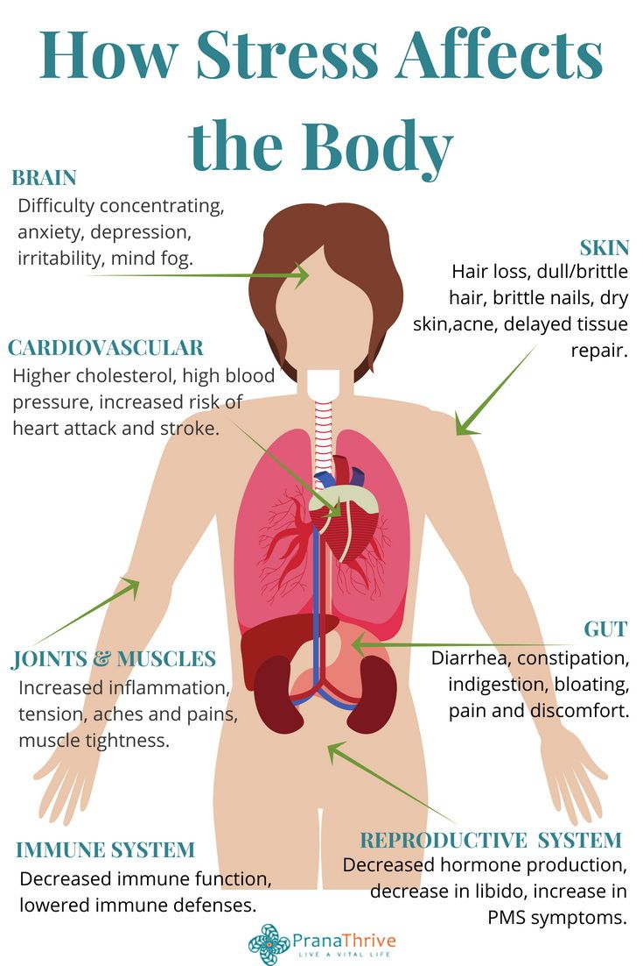
Health Problems Related to Stress
Heart disease:
Researchers have long suspected that the stressed-out, type A personality has a higher risk of high blood pressure and heart problems. ...
Asthma. ...
Obesity. ...
Diabetes. ...
Headaches. ...
Depression and anxiety. ...
Gastrointestinal problems. ...
Alzheimer's disease.
Accelerated aging.
Premature Death

Slide 13
HOW TO OVERCOME AND MANAGE STRESS
Teens can decrease stress with the following behaviors and techniques:
Involve them exercise, meditation, yoga, relaxation therapies and make treatment regularly.
Avoid excess caffeine intake which can increase feelings of anxiety and agitation
Avoid illegal drugs, alcohol and tobacco
Learn relaxation exercises (abdominal breathing and muscle relaxation techniques)
Develop assertiveness training skills. For example, state feelings in polite firm and not overly aggressive or passive ways: ("I feel angry when you yell at me” "Please stop yelling.”)
Rehearse and practice situations which cause stress. One example is taking a speech class if talking in front of a class makes you anxious.
Learn practical coping skills. For example, break a large task into smaller, more attainable tasks .
Parents can help their teen in these ways:
Monitor if stress is affecting their teen's health, behavior, thoughts, or feelings
Listen carefully to teens and watch for overloading
Learn and model stress management skills
Support involvement in sports and other pro-social activities

Slide 14




Decrease negative self talk: challenge negative thoughts about yourself with alternative neutral or positive thoughts. "My life will never get better” can be transformed into "I may feel hopeless now, but my life will probably get better if I work at it and get some help”.
Learn to feel good about doing a competent or "good enough” job rather than demanding perfection from yourself and others.
Take a break from stressful situations. Activities like listening to music, talking to a friend, drawing, writing, or spending time with a pet can reduce stress.
Build a network of friends who help you cope in a positive .

